Slide 1
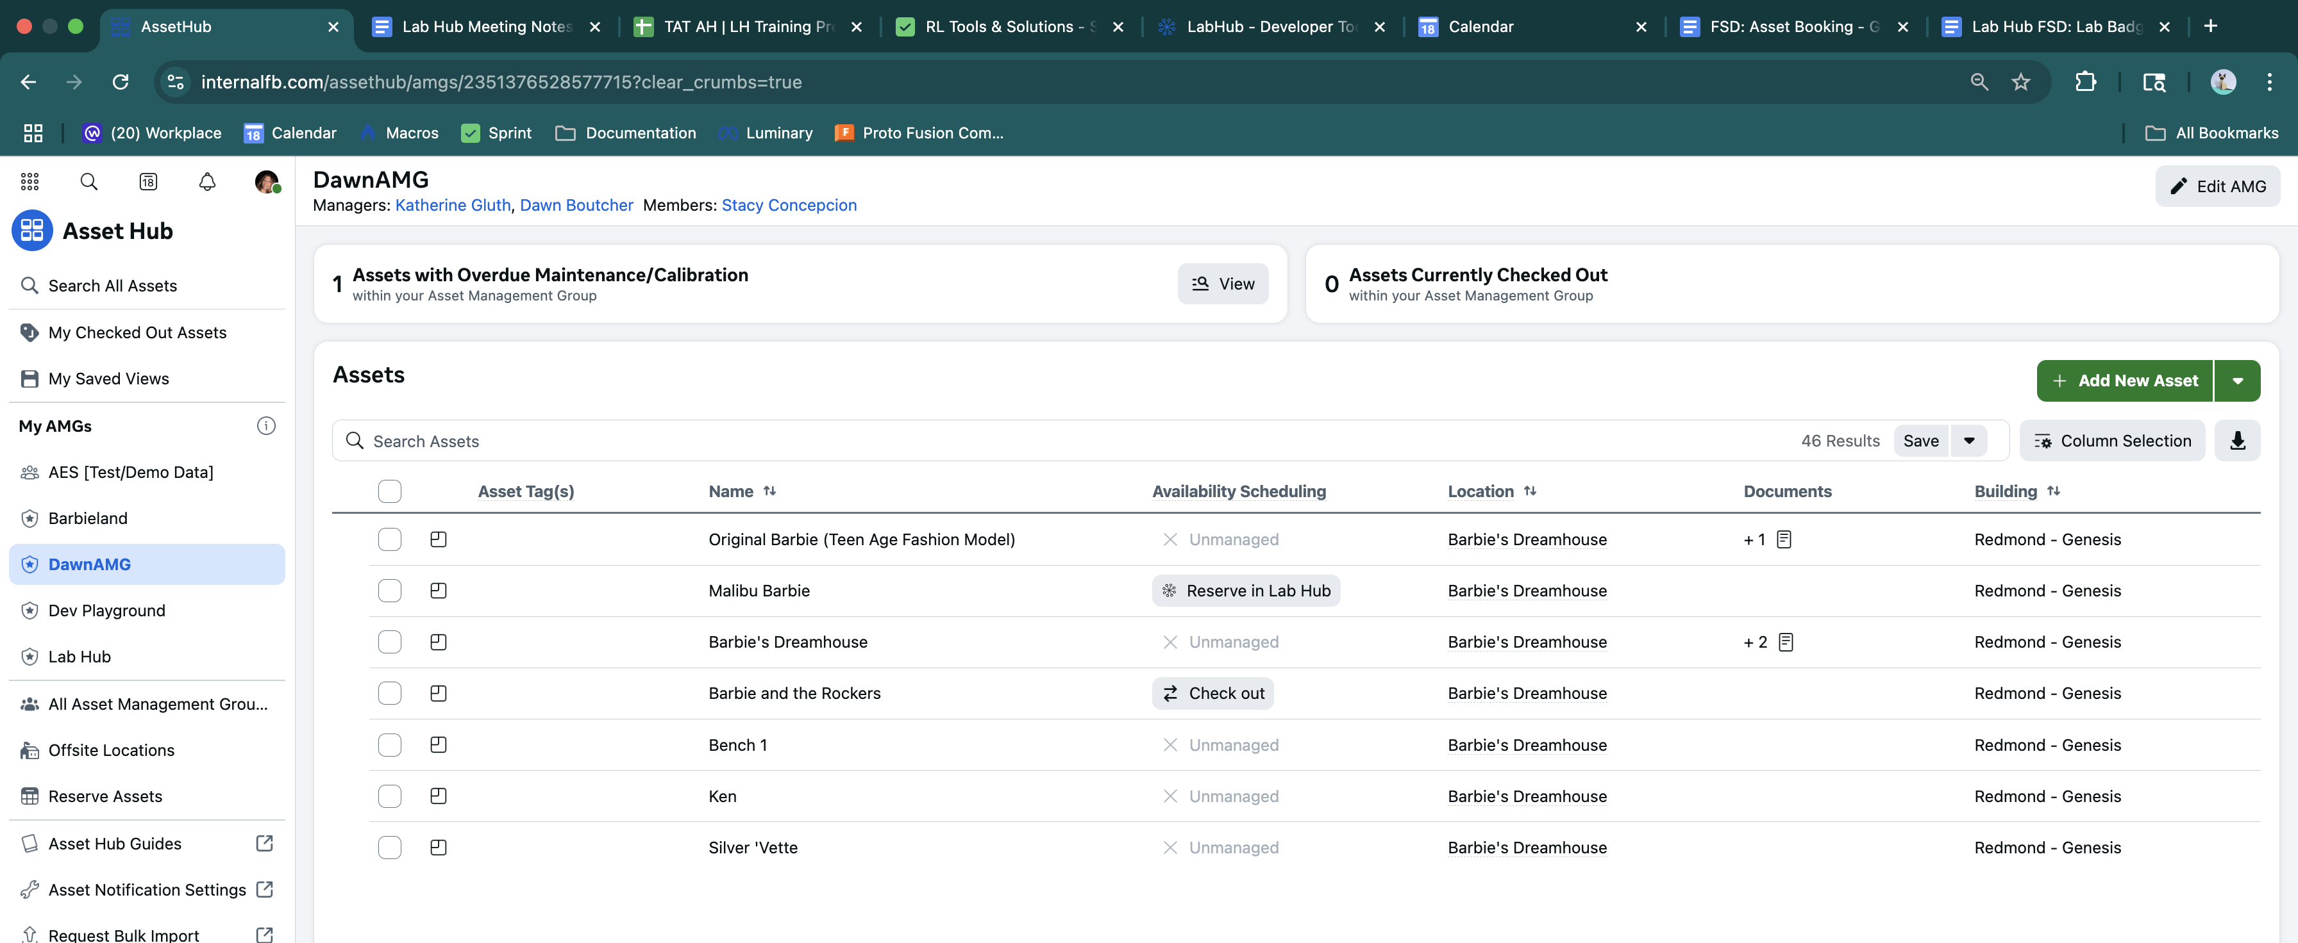
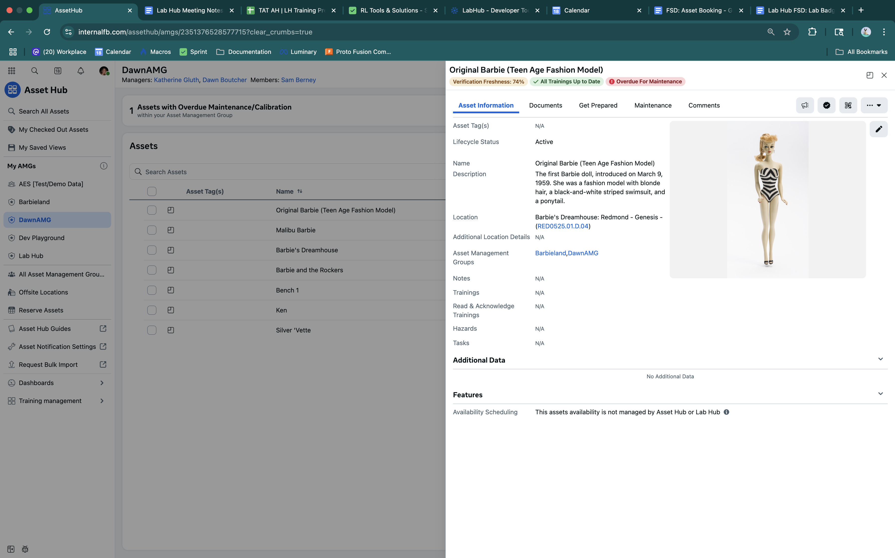
Asset Hub
The Business Need
Reality Labs lacked a unified asset and maintenance management (CMMS) solution. Teams used disconnected tools and spreadsheets, leading to inefficiencies, redundant licensing costs, and inconsistent reporting.
What We Did
Affirma developed a scalable asset and maintenance management system on Meta’s internal platforms. The system centralized maintenace workflows, enabled robust inventory control, enforcement of asset reservations and training, and empowered admins with real-time equipment data.
Managed Service Team
Full Time Project Manager, 2 Full Time Software Engineers
Services & Technology
Intern
Mobile Home
Email Reminders
React & Ent Development
User Experience & Usability Design
Change Management

